Slide 1
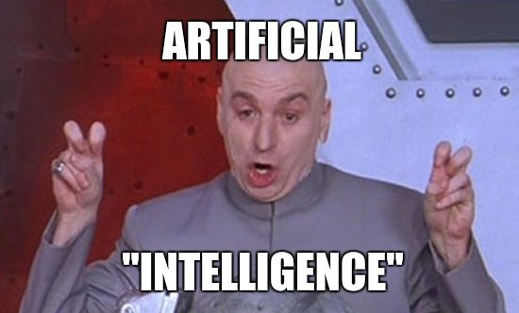
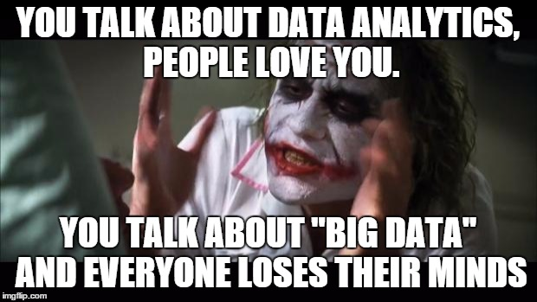
Machine learning
Background, Dimensionality Reduction

Slide 2
Topics
Introduction: GUI and basic calculations
Coding 1: Scripts, style, and variable classes
Coding 2: Control statements and loops
Visualization 1: Basics, subplots, get and set
Coding 3: Functions
Visualization 2: Descriptive plots
Coding 4: Basic input and output
Visualization 3: Distribution and 3D plots
Coding 5: Input and output specials – last lecture before holidays
Machine Learning 1: Introduction and dimension reduction
Machine Learning 2: Clustering
Machine Learning 3: Classification
Coding 6: Efficiency and debugging basics
Coding 7: Advanced functions and debugging

Slide 3
Artificial Intelligence
Intelligence in machines
Contains reasoning, planning, language processing, perception and action control (amongst others)
„Intelligent“ is not as defined as it is in psychology
Weak AI (narrow problem solver, expert systems) vs. Strong AI (conscious?, general?)
Ongoing debates, no clear conclusions
AI as a buzzword is used very widely, "AI is whatever hasn't been done yet.“ (Tesler's Theorem)
Anything with learning and problem solving
Anything to sell to your CEO
Philosophical considerations about “Artificial Intelligence/Consciousness” often have nothing to do with what’s actually there
Artificial Intelligence (AI) ~= Machine Learning (ML)
ML can be a tool to create AI

Slide 4
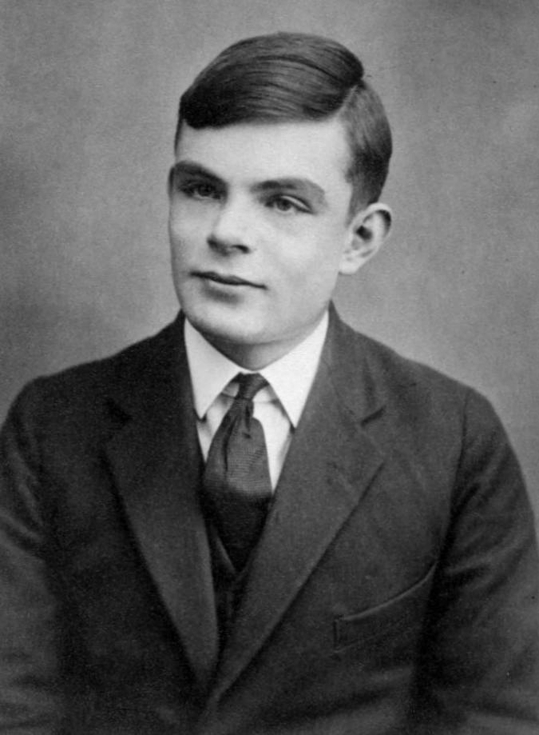
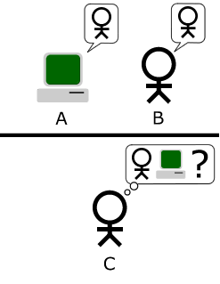
The Turing Test (Imitation Game)
Alan Turing (1912-1954)
Father of theoretical computer science and AI
Turing Machine (theoretical general purpose computer)
Tragic death (cyanide poisoning) after chemical castration (against homosexuality)
Rehabilitation by the Queen only in 2013!
Test whether a machine would exhibit intellgient behavior that is indistinguishable from a human
Interrogation by a human of two conversation partners
One AI and one human
Text-only
Human judge decides who is the machine
If indistinguishable, test is passed
Pass ~= Strong AI (c.f. Chinese Room)
Generalized AI probably
Rather a theoretical question than serious research!
https://de.wikipedia.org/wiki/Alan_Turing
https://de.wikipedia.org/wiki/Turing-Test

Slide 5
Machine Learning (ML)
"A computer program is said to learn from experience E with respect to some class of tasks T and performance measure P if its performance at tasks in T, as measured by P, improves with experience E.“ (Tom Mitchell, 1997)
Learn from training data and test on new data
Unsupervised learning (dimensionality reduction, clustering)
Supervised learning (classification, regression)
Reinforcement Learning (more relevant for agents in an environment)

Slide 6
Supervised
Unsupervised
Classification | Clustering
Regression | Dimensionality Reduction
Discrete
Continuous

Slide 7
Example
Discriminating between fish (From: Duda et al., Pattern Classification, 2nd ed., Wiley, 2001)

Slide 8
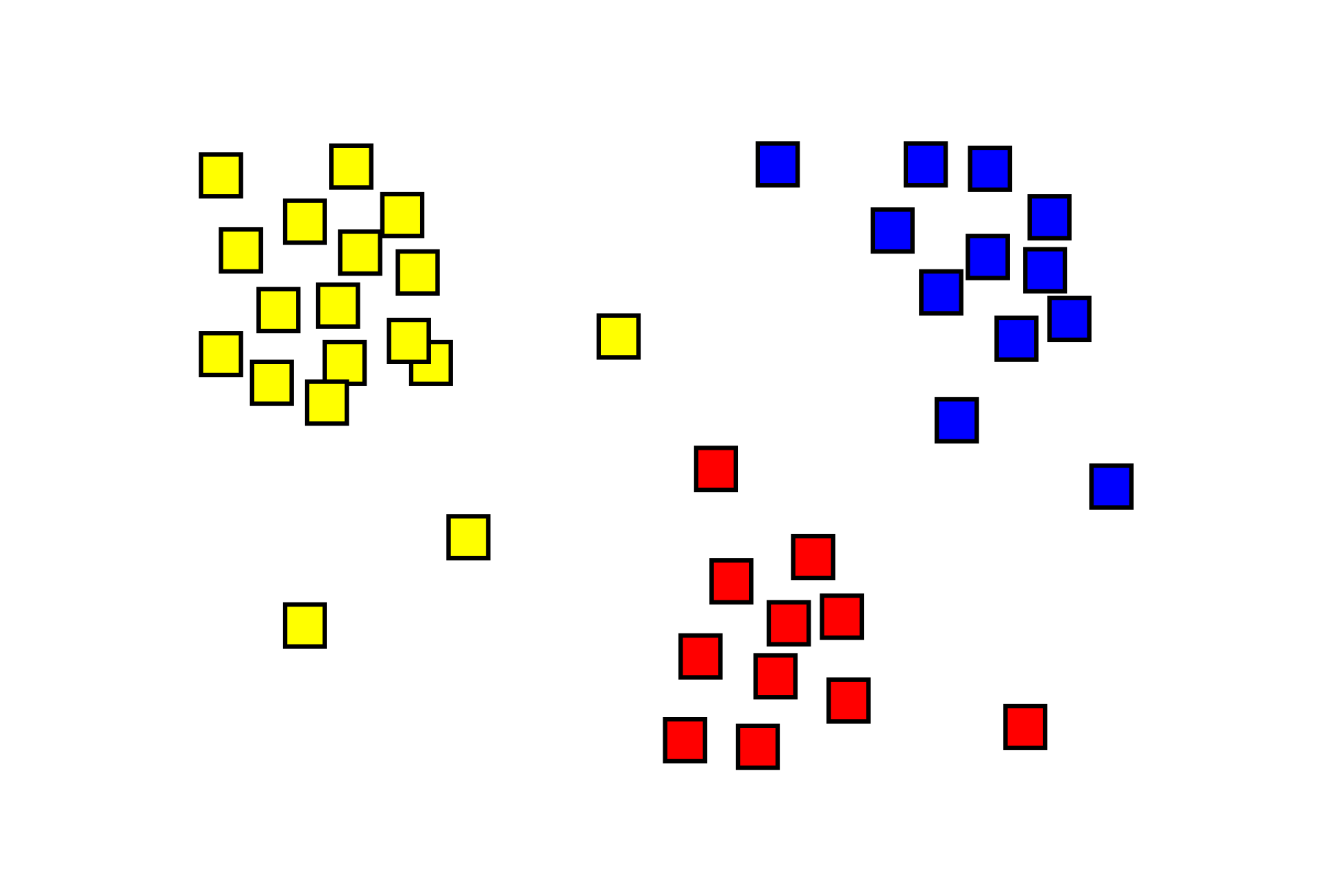
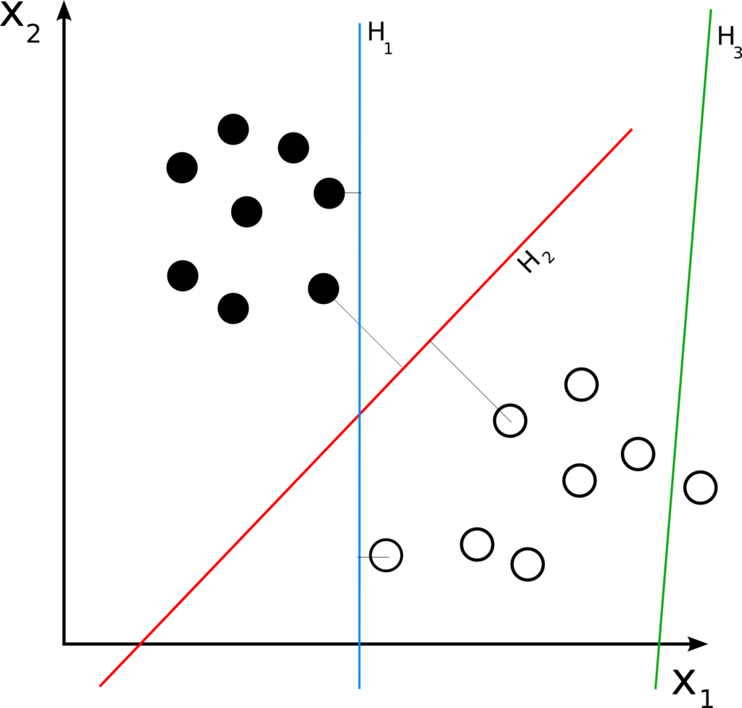
Clustering & Classification
Clustering: What data points belong together?
Classification: Which category does this data point belong to?
https://en.wikipedia.org/wiki/Cluster_analysis
https://en.wikipedia.org/wiki/Linear_classifier

Slide 9
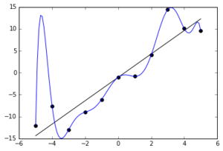
Overfitting
Your model corresponds too closely to the training data, but does not generalize to new data (bad predictions)
Training Error ~= Testing Error
Model complexity << data set size
E.g. factor 10
Duda et al., Pattern Classification, 2nd ed., Wiley, 2001
https://en.wikipedia.org/wiki/Overfitting

Slide 10
Features and Dimensions
Feature Extraction
You have a raw data set, what are the informative values that you derive from it?
Depends on the question!
EEG data -> e.g. power in certain frequencies
Feature Selection
Select a subset of relevant features (variables) for your model
Less features (variables) -> Faster computation, less overfitting
Curse of dimensionality: If the feature space has a very large amount of dimensions, problems arise
E.g. because the data does not fill the entire volume or distances are hard to define
Dimensionality reduction: Reducing the number of dimensions of your feature vector while keeping as much information (variance) in your data as possible
Duda et al., Pattern Classification, 2nd ed., Wiley, 2001

Slide 11
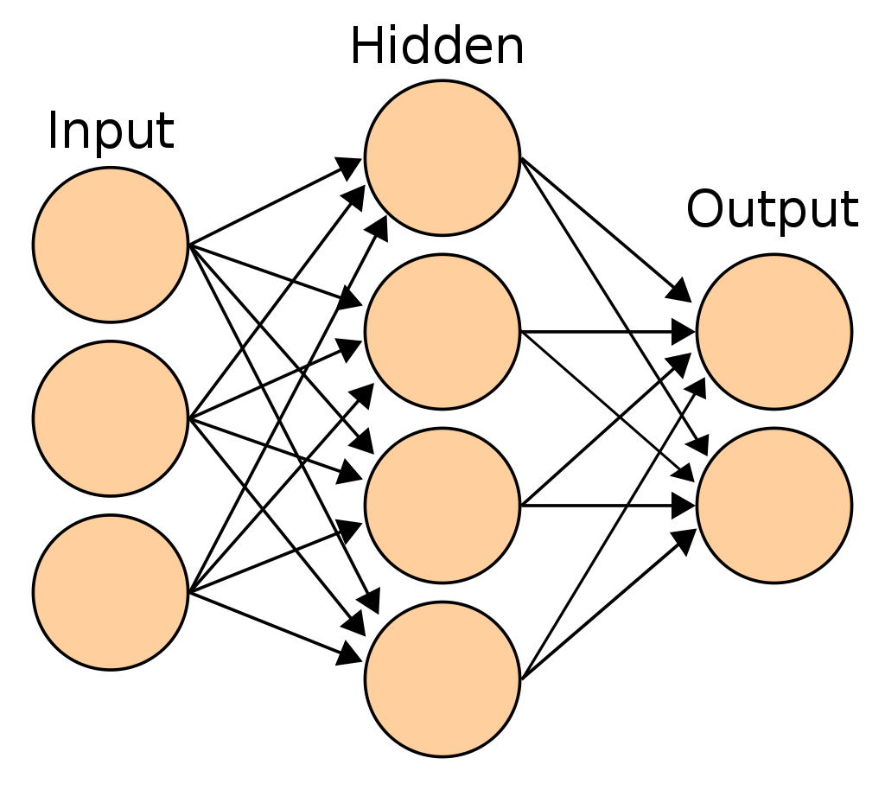


Artificial Neural Networks
“neurons” connect with weights to other neurons
Input, Anonymous, and output layer
Other structures are possible too!
“Activity” (numeric value) spreads through the net
&
Errors are backpropagated to the input
The contribution of each weight and neuron is computed
Weights are changed in the process to minimize the error
Deep Learning: Many Anonymous Layers
Performs feature selection and extraction itself
Needs VERY large amount of data
Hard to interpret how exactly tasks are solved
Think first whether a simple algorithm can work as well!
https://en.wikipedia.org/wiki/Artificial_neural_network

Slide 12
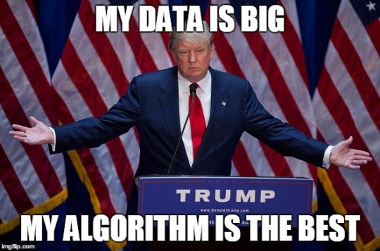
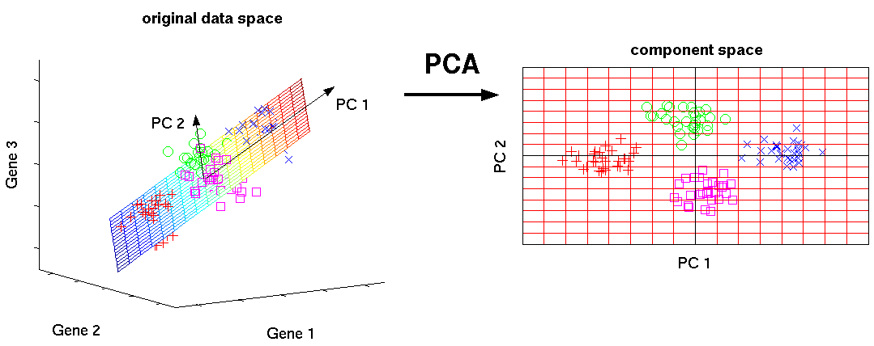
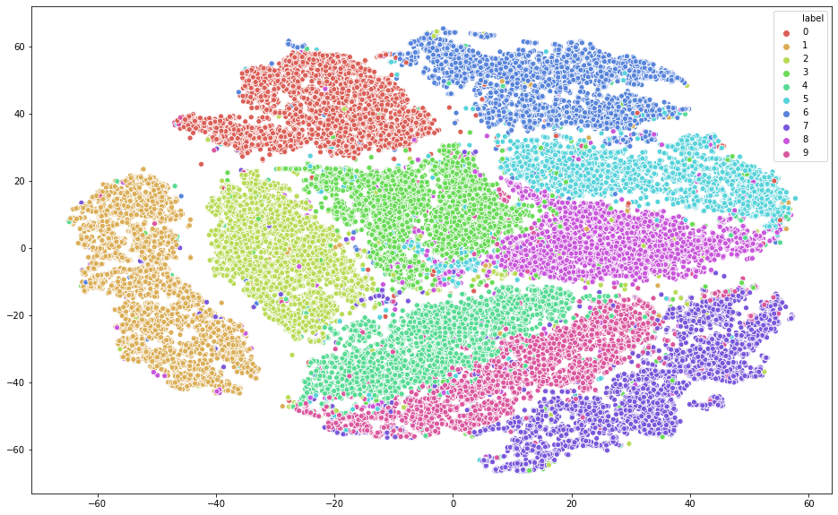
Dimensionality Reduction
Big data -> manageable data (visualize, classify)
Principal Component Analysis (PCA)
Very commonly used (invented in 1901)
Correlated variables are transformed into a set of uncorrelated variables (principal components)
Components are sorted according to their variance
Disregarding components with low variance contribution reduces the dimensions while keeping data variability high
t-Distributed Stochastic Neighbor Embedding (t-SNE)
Projects n-dimensional data into 2D or 3D
Similar objects are modeled by nearby points and dissimilar objects are modeled by distant points with high probability
https://distill.pub/2016/misread-tsne/
https://chanzuckerberg.github.io/scRNA-python-workshop/preprocessing/02-normalization.html
https://towardsdatascience.com/dimensionality-reduction-using-t-distributed-stochastic-neighbor-embedding-t-sne-on-the-mnist-9d36a3dd4521

